Slide 1
A2 Review Unit 4
Quadratic functions — questions 1 to 4. Choose a question.
Question 1
y = 2x² − 4x − 2
Question 2
y = −½x² + 2x − 1
Question 3
y = −½(x + 2)² − 1
Question 4
y = (x − 1)² + 3

Slide 2
Question 1
Home
y = 2x² − 4x − 2
Click a button to see the answer and the explanation.
Form
Opening
Width
Vertex
Axis of sym.
y-int.
Graph
Min/Max
Dom & Range

Slide 3
Question 1 · Form
← Question
Home
y = 2x² − 4x − 2
Opening
General form
Width
Vertex
The equation is of the form y = ax² + bx + c.
Therefore it is in general form.
Axis of sym.
y-int.
Graph
Min/Max
Dom & Range

Slide 4
Question 1 · Opening
← Question
Home
y = 2x² − 4x − 2
Form
The graph opens up
Width
Vertex
a = 2.
a is positive; there is no reflection over the x-axis, therefore the graph opens up.
Axis of sym.
y-int.
Graph
Min/Max
Dom & Range

Slide 5
Question 1 · Width
← Question
Home
y = 2x² − 4x − 2
Form
Narrower than y = x²
Opening
Vertex
|2| > 1, so the graph is stretched.
Therefore it is narrower than the graph of the parent function y = x².
Axis of sym.
y-int.
Graph
Min/Max
Dom & Range

Slide 6
Question 1 · Vertex
← Question
Home
y = 2x² − 4x − 2
Form
Vertex: (1, −4)
Opening
Width
x-coordinate: use x = −b/(2a). Here b = −4 and a = 2.
x = −(−4) / (2·2) = 1
y-coordinate: plug in 1 for x.
y = 2(1)² − 4(1) − 2 = −4
Axis of sym.
y-int.
Graph
Min/Max
Dom & Range

Slide 7
Question 1 · Axis of Symmetry
← Question
Home
y = 2x² − 4x − 2
Form
x = 1
Opening
Width
The axis of symmetry is the vertical line going through the vertex (1, −4).
Its equation is x = 1.
Vertex
y-int.
Graph
Min/Max
Dom & Range

Slide 8
Question 1 · y-Intercept
← Question
Home
y = 2x² − 4x − 2
Form
y-intercept: −2
Opening
Width
The y-intercept is the value of y when x = 0.
y = 2(0)² − 4(0) − 2 = −2 → point (0, −2)
Vertex
Axis of sym.
Graph
Min/Max
Dom & Range

Slide 9
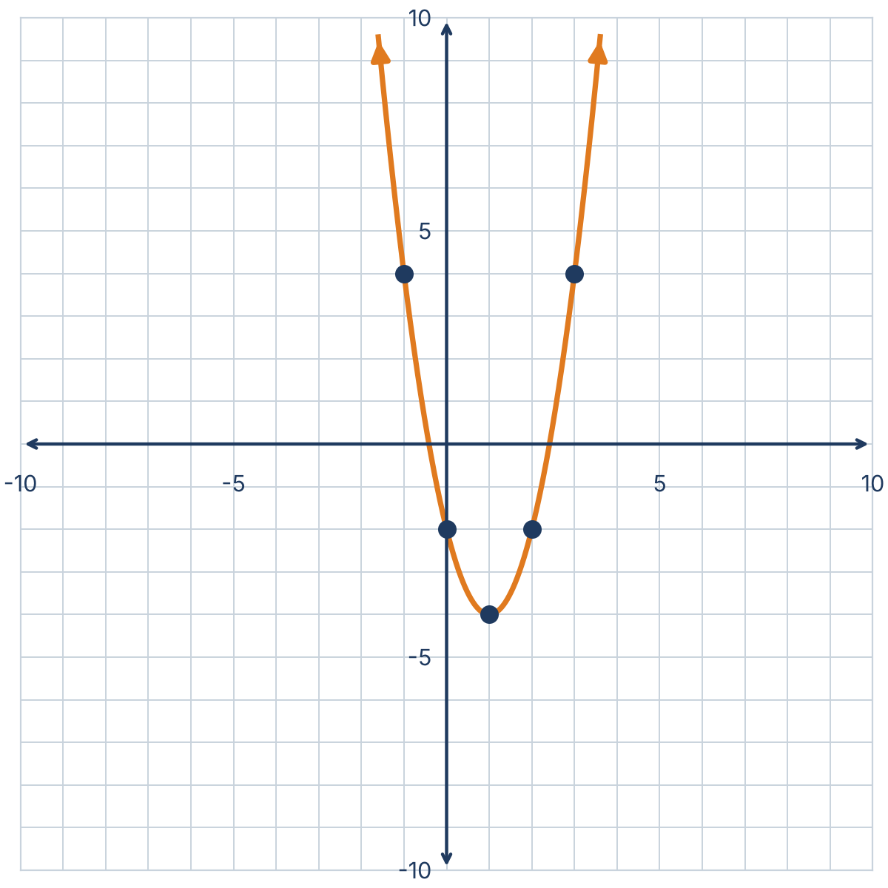
Question 1 · Graph
← Question
Home
y = 2x² − 4x − 2
Form
Points: (1, −4), (0, −2), (2, −2), (3, 4), (−1, 4)
Opening
Width
Start with the vertex (1, −4), the y-intercept (0, −2) and its reflection across x = 1: (2, −2).
Choose x = 3: y = 2(3)² − 4(3) − 2 = 4 → (3, 4).
Reflect across the axis: (−1, 4).
Vertex
Axis of sym.
y-int.
Min/Max
Dom & Range

Slide 10
Question 1 · Minimum / Maximum
← Question
Home
y = 2x² − 4x − 2
Form
Minimum of −4 at x = 1
Opening
Width
The graph opens up, so the vertex is the lowest point.
The minimum value is −4 and it occurs at x = 1.
Vertex
Axis of sym.
y-int.
Graph
Dom & Range

Slide 11
Question 1 · Domain & Range
← Question
Home
y = 2x² − 4x − 2
Form
Domain: (−∞, ∞) Range: [−4, ∞)
Opening
Width
Any real number can be used for x.
The graph opens up with a minimum of −4, so y ≥ −4.
Vertex
Axis of sym.
y-int.
Graph
Min/Max

Slide 12
Question 2
Home
y = −½x² + 2x − 1
Click a button to see the answer and the explanation.
Form
Opening
Width
Vertex
Axis of sym.
y-int.
Graph
Min/Max
Dom & Range

Slide 13
Question 2 · Form
← Question
Home
y = −½x² + 2x − 1
Opening
General form
Width
Vertex
The equation is of the form y = ax² + bx + c.
Therefore it is in general form.
Axis of sym.
y-int.
Graph
Min/Max
Dom & Range

Slide 14
Question 2 · Opening
← Question
Home
y = −½x² + 2x − 1
Form
The graph opens down
Width
Vertex
a = −½.
a is negative; there is a reflection over the x-axis, therefore the graph opens down.
Axis of sym.
y-int.
Graph
Min/Max
Dom & Range

Slide 15
Question 2 · Width
← Question
Home
y = −½x² + 2x − 1
Form
Wider than y = x²
Opening
Vertex
|−½| < 1, so the graph is compressed.
Therefore it is wider than the graph of the parent function y = x².
Axis of sym.
y-int.
Graph
Min/Max
Dom & Range

Slide 16
Question 2 · Vertex
← Question
Home
y = −½x² + 2x − 1
Form
Vertex: (2, 1)
Opening
Width
x-coordinate: use x = −b/(2a). Here b = 2 and a = −½.
x = −2 / (2·(−½)) = −2 / (−1) = 2
y-coordinate: plug in 2 for x.
y = −½(2)² + 2(2) − 1 = −2 + 4 − 1 = 1
Axis of sym.
y-int.
Graph
Min/Max
Dom & Range

Slide 17
Question 2 · Axis of Symmetry
← Question
Home
y = −½x² + 2x − 1
Form
x = 2
Opening
Width
The axis of symmetry is the vertical line going through the vertex (2, 1).
Its equation is x = 2.
Vertex
y-int.
Graph
Min/Max
Dom & Range

Slide 18
Question 2 · y-Intercept
← Question
Home
y = −½x² + 2x − 1
Form
y-intercept: −1
Opening
Width
The y-intercept is the value of y when x = 0.
y = −½(0)² + 2(0) − 1 = −1 → point (0, −1)
Vertex
Axis of sym.
Graph
Min/Max
Dom & Range

Slide 19
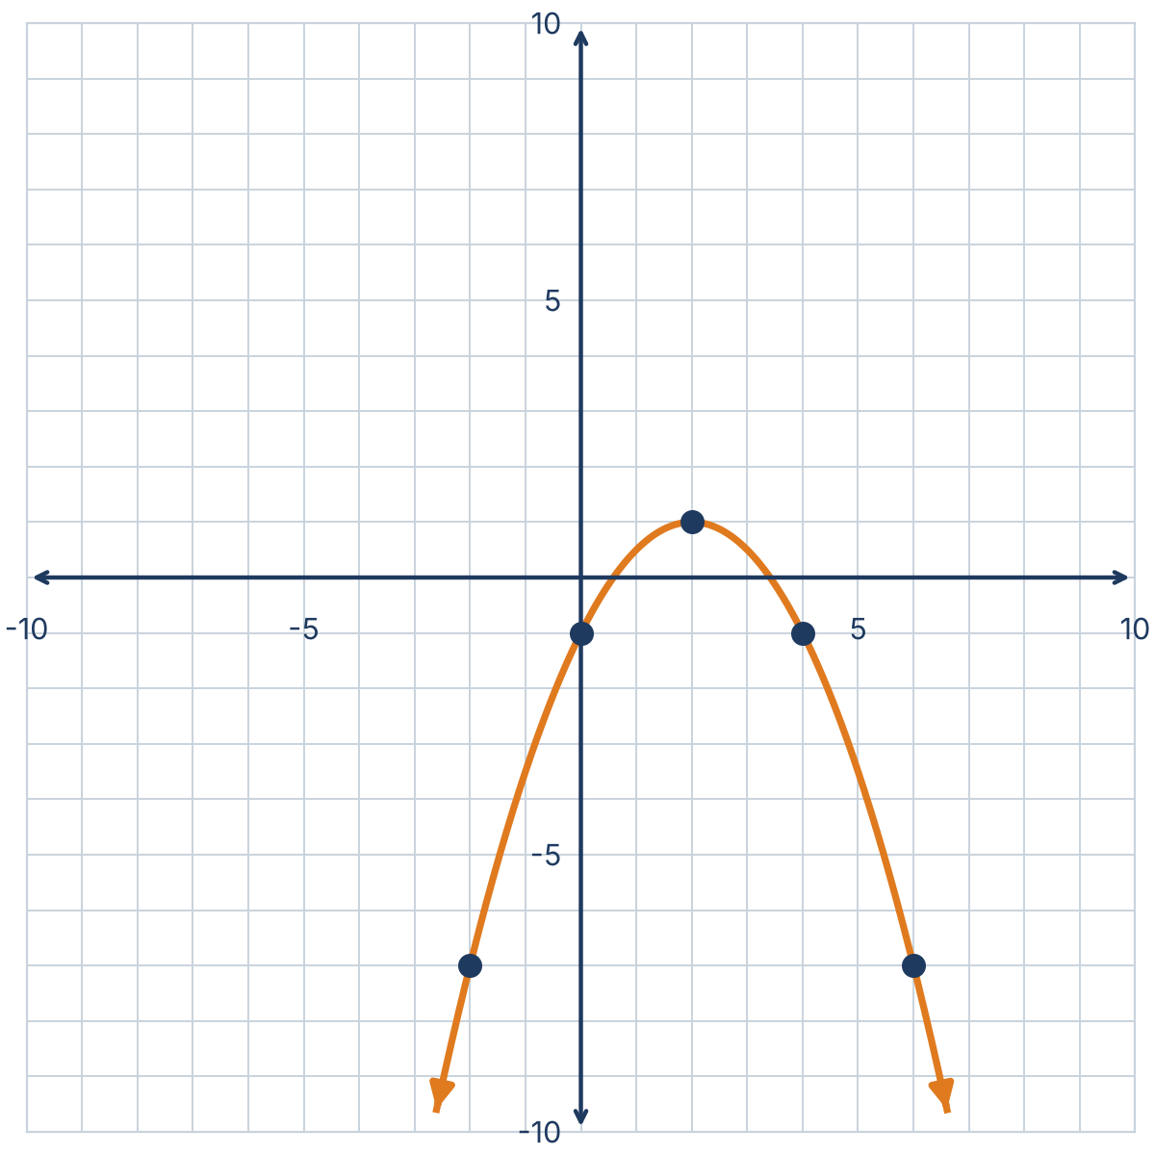
Question 2 · Graph
← Question
Home
y = −½x² + 2x − 1
Form
Points: (2, 1), (0, −1), (4, −1), (−2, −7), (6, −7)
Opening
Width
Start with the vertex (2, 1), the y-intercept (0, −1) and its reflection across x = 2: (4, −1).
Choose x = −2: y = −½(−2)² + 2(−2) − 1 = −7 → (−2, −7).
Reflect across the axis: (6, −7).
Vertex
Axis of sym.
y-int.
Min/Max
Dom & Range

Slide 20
Question 2 · Minimum / Maximum
← Question
Home
y = −½x² + 2x − 1
Form
Maximum of 1 at x = 2
Opening
Width
The graph opens down, so the vertex is the highest point.
The maximum value is 1 and it occurs at x = 2.
Vertex
Axis of sym.
y-int.
Graph
Dom & Range

Slide 21
Question 2 · Domain & Range
← Question
Home
y = −½x² + 2x − 1
Form
Domain: (−∞, ∞) Range: (−∞, 1]
Opening
Width
Any real number can be used for x.
The graph opens down with a maximum of 1, so y ≤ 1.
Vertex
Axis of sym.
y-int.
Graph
Min/Max

Slide 22
Question 3
Home
y = −½(x + 2)² − 1
Click a button to see the answer and the explanation.
Form
Opening
Width
Vertex
Axis of sym.
y-int.
Graph
Min/Max
Dom & Range

Slide 23
Question 3 · Form
← Question
Home
y = −½(x + 2)² − 1
Opening
Vertex form
Width
Vertex
The equation is of the form y = a(x − h)² + k.
Therefore it is in vertex form.
Axis of sym.
y-int.
Graph
Min/Max
Dom & Range

Slide 24
Question 3 · Opening
← Question
Home
y = −½(x + 2)² − 1
Form
The graph opens down
Width
Vertex
a = −½.
a is negative; there is a reflection over the x-axis, therefore the graph opens down.
Axis of sym.
y-int.
Graph
Min/Max
Dom & Range

Slide 25
Question 3 · Width
← Question
Home
y = −½(x + 2)² − 1
Form
Wider than y = x²
Opening
Vertex
|−½| < 1, so the graph is compressed.
Therefore it is wider than the graph of the parent function y = x².
Axis of sym.
y-int.
Graph
Min/Max
Dom & Range

Slide 26
Question 3 · Vertex
← Question
Home
y = −½(x + 2)² − 1
Form
Vertex: (−2, −1)
Opening
Width
In vertex form, the vertex is the point (h, k).
y = −½(x − (−2))² + (−1), so h = −2 and k = −1.
Axis of sym.
y-int.
Graph
Min/Max
Dom & Range

Slide 27
Question 3 · Axis of Symmetry
← Question
Home
y = −½(x + 2)² − 1
Form
x = −2
Opening
Width
The axis of symmetry is the vertical line going through the vertex (−2, −1).
Its equation is x = −2.
Vertex
y-int.
Graph
Min/Max
Dom & Range

Slide 28
Question 3 · y-Intercept
← Question
Home
y = −½(x + 2)² − 1
Form
y-intercept: −3
Opening
Width
The y-intercept is the value of y when x = 0.
y = −½(0 + 2)² − 1 = −2 − 1 = −3 → point (0, −3)
Vertex
Axis of sym.
Graph
Min/Max
Dom & Range

Slide 29
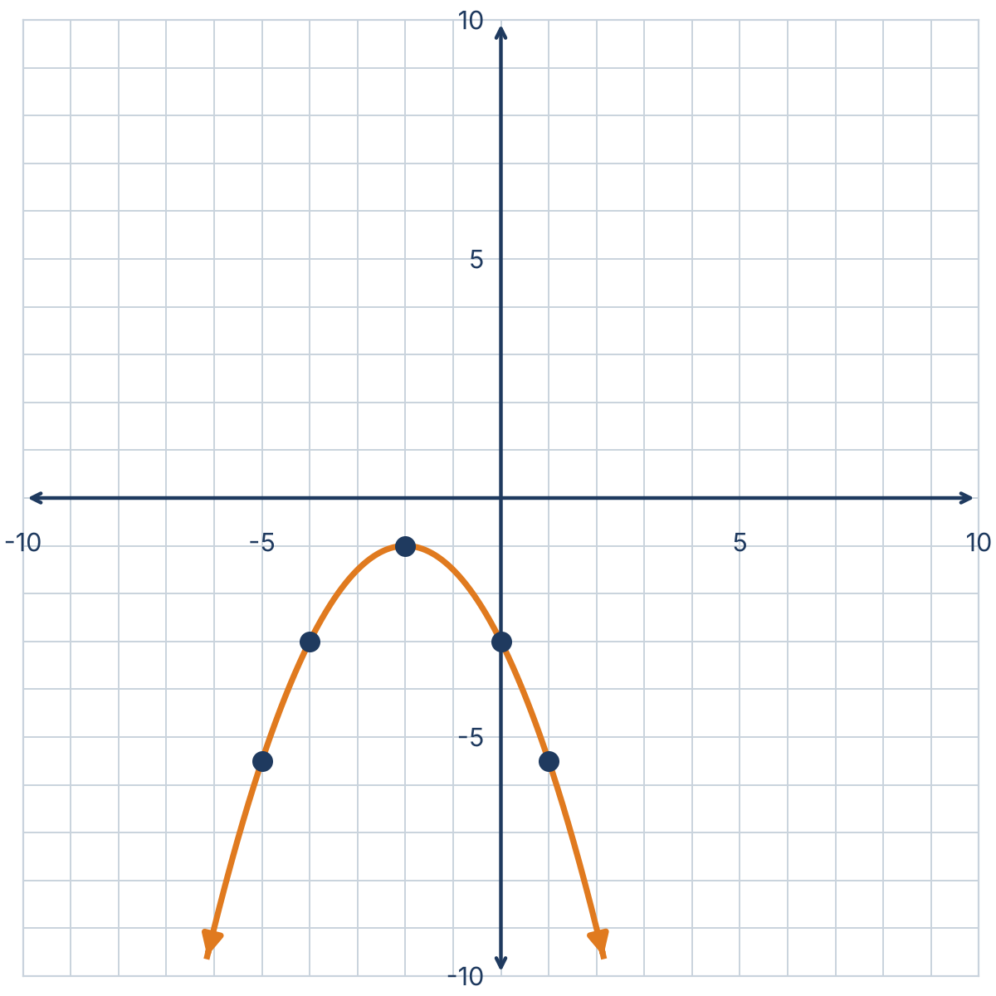
Question 3 · Graph
← Question
Home
y = −½(x + 2)² − 1
Form
Points: (−2, −1), (0, −3), (−4, −3), (1, −11/2), (−5, −11/2)
Opening
Width
Start with the vertex (−2, −1), the y-intercept (0, −3) and its reflection across x = −2: (−4, −3).
Choose x = 1: y = −½(1 + 2)² − 1 = −11/2 → (1, −11/2).
Reflect across the axis: (−5, −11/2).
Vertex
Axis of sym.
y-int.
Min/Max
Dom & Range

Slide 30
Question 3 · Minimum / Maximum
← Question
Home
y = −½(x + 2)² − 1
Form
Maximum of −1 at x = −2
Opening
Width
The graph opens down, so the vertex is the highest point.
The maximum value is −1 and it occurs at x = −2.
Vertex
Axis of sym.
y-int.
Graph
Dom & Range

Slide 31
Question 3 · Domain & Range
← Question
Home
y = −½(x + 2)² − 1
Form
Domain: (−∞, ∞) Range: (−∞, −1]
Opening
Width
Any real number can be used for x.
The graph opens down with a maximum of −1, so y ≤ −1.
Vertex
Axis of sym.
y-int.
Graph
Min/Max

Slide 32
Question 4
Home
y = (x − 1)² + 3
Click a button to see the answer and the explanation.
Form
Opening
Width
Vertex
Axis of sym.
y-int.
Graph
Min/Max
Dom & Range

Slide 33
Question 4 · Form
← Question
Home
y = (x − 1)² + 3
Opening
Vertex form
Width
Vertex
The equation is of the form y = a(x − h)² + k.
Therefore it is in vertex form.
Axis of sym.
y-int.
Graph
Min/Max
Dom & Range

Slide 34
Question 4 · Opening
← Question
Home
y = (x − 1)² + 3
Form
The graph opens up
Width
Vertex
a = 1.
a is positive; there is no reflection over the x-axis, therefore the graph opens up.
Axis of sym.
y-int.
Graph
Min/Max
Dom & Range

Slide 35
Question 4 · Width
← Question
Home
y = (x − 1)² + 3
Form
Same width as y = x²
Opening
Vertex
|1| = 1, so there is no stretch and no compression.
Therefore it has the same width as the graph of the parent function y = x².
Axis of sym.
y-int.
Graph
Min/Max
Dom & Range

Slide 36
Question 4 · Vertex
← Question
Home
y = (x − 1)² + 3
Form
Vertex: (1, 3)
Opening
Width
In vertex form, the vertex is the point (h, k).
y = 1(x − 1)² + 3, so h = 1 and k = 3.
Axis of sym.
y-int.
Graph
Min/Max
Dom & Range

Slide 37
Question 4 · Axis of Symmetry
← Question
Home
y = (x − 1)² + 3
Form
x = 1
Opening
Width
The axis of symmetry is the vertical line going through the vertex (1, 3).
Its equation is x = 1.
Vertex
y-int.
Graph
Min/Max
Dom & Range

Slide 38
Question 4 · y-Intercept
← Question
Home
y = (x − 1)² + 3
Form
y-intercept: 4
Opening
Width
The y-intercept is the value of y when x = 0.
y = (0 − 1)² + 3 = 1 + 3 = 4 → point (0, 4)
Vertex
Axis of sym.
Graph
Min/Max
Dom & Range

Slide 39
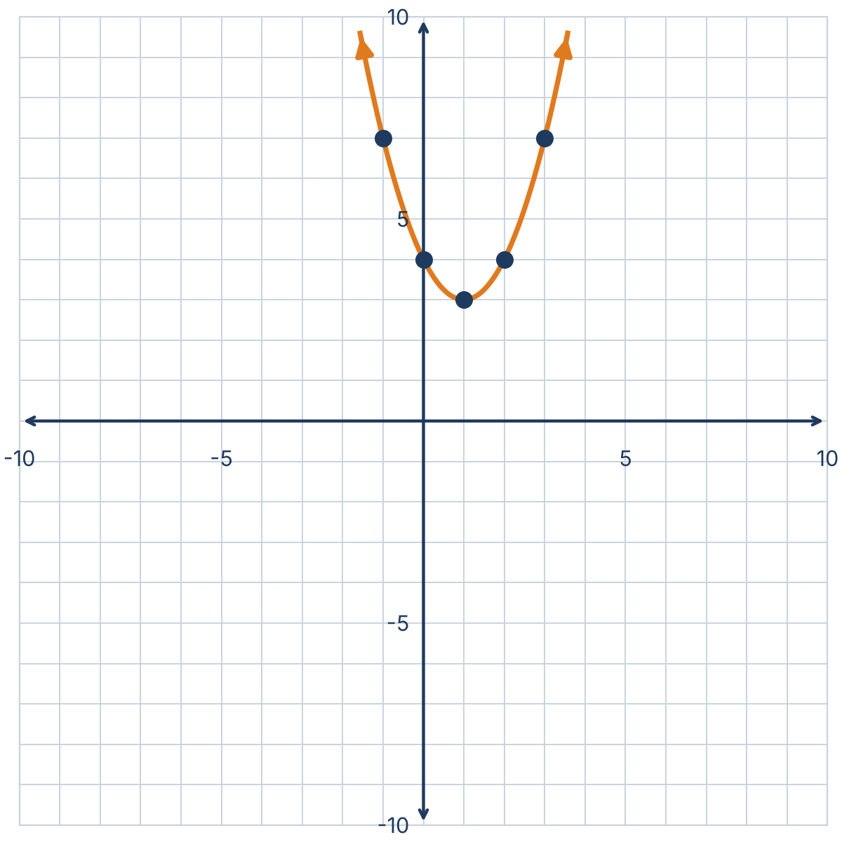
Question 4 · Graph
← Question
Home
y = (x − 1)² + 3
Form
Points: (1, 3), (0, 4), (2, 4), (3, 7), (−1, 7)
Opening
Width
Start with the vertex (1, 3), the y-intercept (0, 4) and its reflection across x = 1: (2, 4).
Choose x = 3: y = (3 − 1)² + 3 = 7 → (3, 7).
Reflect across the axis: (−1, 7).
Vertex
Axis of sym.
y-int.
Min/Max
Dom & Range

Slide 40
Question 4 · Minimum / Maximum
← Question
Home
y = (x − 1)² + 3
Form
Minimum of 3 at x = 1
Opening
Width
The graph opens up, so the vertex is the lowest point.
The minimum value is 3 and it occurs at x = 1.
Vertex
Axis of sym.
y-int.
Graph
Dom & Range

Slide 41
Question 4 · Domain & Range
← Question
Home
y = (x − 1)² + 3
Form
Domain: (−∞, ∞) Range: [3, ∞)
Opening
Width
Any real number can be used for x.
The graph opens up with a minimum of 3, so y ≥ 3.
Vertex
Axis of sym.
y-int.
Graph
Min/Max

